Slide 1
THE Partnership Phonics Programme
Reading with your child at home

Slide 2
What is reading?
Reading is one of the most important skills we teach children.
Reading has 2 components
Word recognition – the ability to recognise words in and out of context and the ability to apply phonics
Comprehension – the ability to process text, understand its meaning, and to integrate with what the reader already knows. Comprehension is a big focus in year 2.

Slide 3
What is the importance of reading?
‘We want children to learn to read so they can read to learn for the rest of their lives’.
Learning to read is about listening and understanding, as well as working out what is printed on the page.
Through hearing stories, children are exposed to a wide range of words. This helps them build their own vocabulary and improve their understanding when they listen, which is vital as they start to read.
It gives children a better understanding of the world, people and cultures.
Through reading you build a more solid foundation for communication.
Reading develops a child’s imagination.
Reading helps children develop empathy.

Slide 4
How important are early reading skills?
When children learn to read at an early age they have greater general knowledge, wider vocabulary and become more fluent readers.
Children have an improved attention span and better concentration.
Their proficiency in reading helps them to comprehend what they read.

Slide 5
What are the characteristics of reading?
Word reading
Reading fluency – expression, intonation and punctuation
Pace and rhythm
Vocabulary
Background knowledge
Working memory
Comprehension

Slide 6
Spoken language and Vocabulary
Spoken language underpins the development of reading and writing.
Quality and variety of language heard and spoken is vital for developing vocabulary, grammar and understanding for reading and writing.
Teach the children the meaning of new words, repetition of the words is very important for children to embed in their vocabulary.
If children do not have a love of words they will never become great readers let alone great writers.
A child needs to hear a word 4-12 times before it becomes part of their vocabulary.
Use the words in sentences so the children are able to understand the exact meaning of the word.

Slide 7
Comprehension and Context Clues
Key comprehension strategies:
Prior knowledge
Predicting
Identifying main ideas
Questioning
Making inference
Retelling /sequencing
Visualising

Slide 8
Why is fluency important?
For children to be fluent readers they must read
accurately
smoothly
with expression and comprehension
with pace and rhythm (punctuation)
Fluent readers recognise words automatically without struggling over decoding issues.
Fluency is important because it bridges between word recognition and comprehension. It allows the child to focus on what the text is saying.
Children should be reading about 120 words per minute for fluency

Slide 9
What causes reading fluency problems?
Most common causes are
Lack of reading practice
Word recognition difficulties
Children stumble on particular words
Lack of recognition of words automatically
Children sounding out too many words
Comprehension difficulties also disrupt fluency, e.g. a child not understanding what is read.

Slide 10
How do we teach reading at English Martyrs in Reception and KS1?
We teach reading through:
Phonics
A language rich environment
Word recognition/flashcards
Vocabulary
Spoken language
Comprehension
Context clues
Reading stories aloud to children
Teacher modelling children echoing
Using texts with repeated words

Slide 11
Approach to reading in KS1
Whole class
Guided
1:1
Shared/paired read
Reading for pleasure – silent reading
Class novel
Story time
Home/school reading
Reading across the curriculum
Reading for writing

Slide 12
What is phonics?
Phonics -
method for teaching reading and writing and understanding that letters represent sounds to form words.
it involves teaching the sounds made by individual letters and letter groups and how they blend together to make words.
is essential for children to become successful readers, writers and spellers in the Early Years and beyond.

Slide 13
Is phonics important in learning to read?
Yes because letter/sound knowledge is the foundation needed to build up reading and writing skills.
Research shows phonics to be a corner stone of effective early reading. Phonics enable beginner readers to decode unknown written words by sounding them out which is essential for independent reading.

Slide 14
Phonics
Phonics help children to decode.
Increases fluency and reading accuracy
Helps comprehension
Increases vocabulary

Slide 15
Helping your child to read is one of the most useful things you can do for them.
It will help them gain confidence in learning in many other subjects and gives a great step-up into life beyond school.

Slide 16
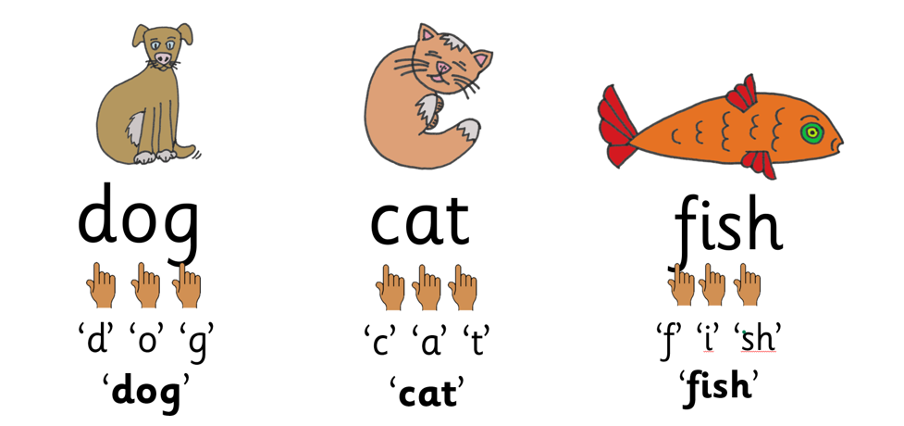
We teach learning to read through phonics.
Phonics is the matching of sounds to letters and groups of letters and then blending the sounds together to read words.

Slide 17
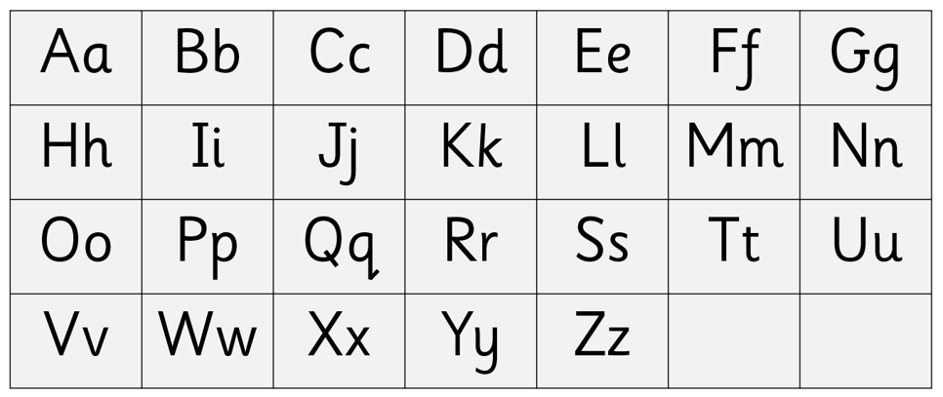
There are 26 letters in the alphabet.

Slide 18
There are 44 English speech sounds.

Slide 19
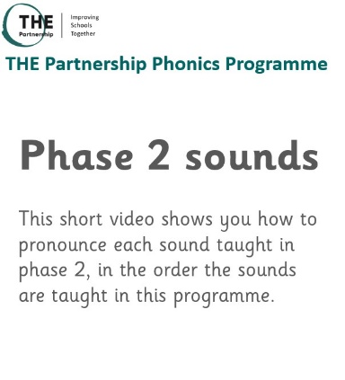
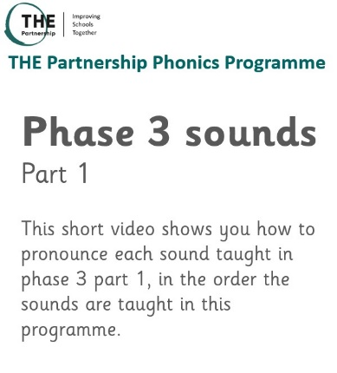
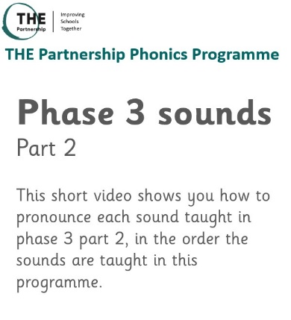
https://youtu.be/6DE37N5LE_8
https://youtu.be/oxVUGHj2MuM
https://youtu.be/fSPGOjZq2Dc

Slide 20
There are four key concepts that we teach to all pupils, these are:
Letters are symbols (spellings) that represent sounds.
A sound may be spelled by one, two, three or four letters:
E.g. dog street night eight
The same sound can be spelled in more than one way:
E.g. rain acorn cake day
Many spellings can represent more than one sound:
E.g. head seat break

Slide 21
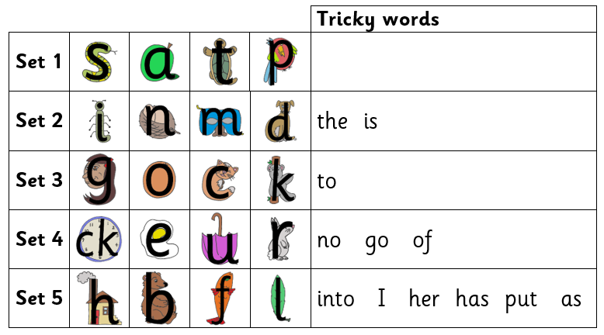
The phonics programme progresses from simple to more complex phonic knowledge and skills.
Thee programme begins with:

Slide 22
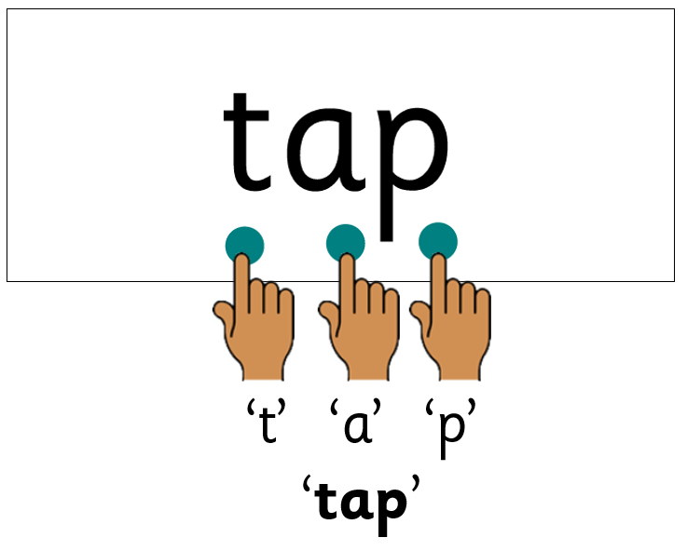
Reading words
Sometimes the word has the sound buttons added to help your child see each sound.
The aim for your child to read words without the sound buttons.

Slide 23
There are also some words which contain sound combinations your child has not yet learned.
These are called tricky words.
Your child is told why they are tricky with the letter/sound combination explained in school.
In the word ‘is’, the ‘s’ makes a /z/ sound.

Slide 24
Your child will learn to read sentences.
“If you sound out a word, re-read the word and start the sentence again.”

Slide 26
Spelling words
As your child is learning phonics, they will be learning how to use their growing phonic knowledge to spell words.
When your child wants to spell a word, they will think about all the sounds in the word, one by one.
Then, they will match a sound-spelling to each sound to write the word.

Slide 28
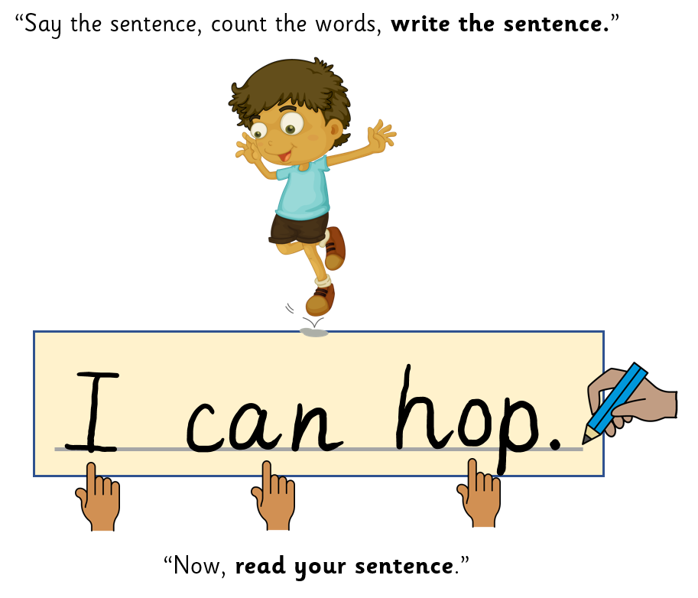

Slide 29
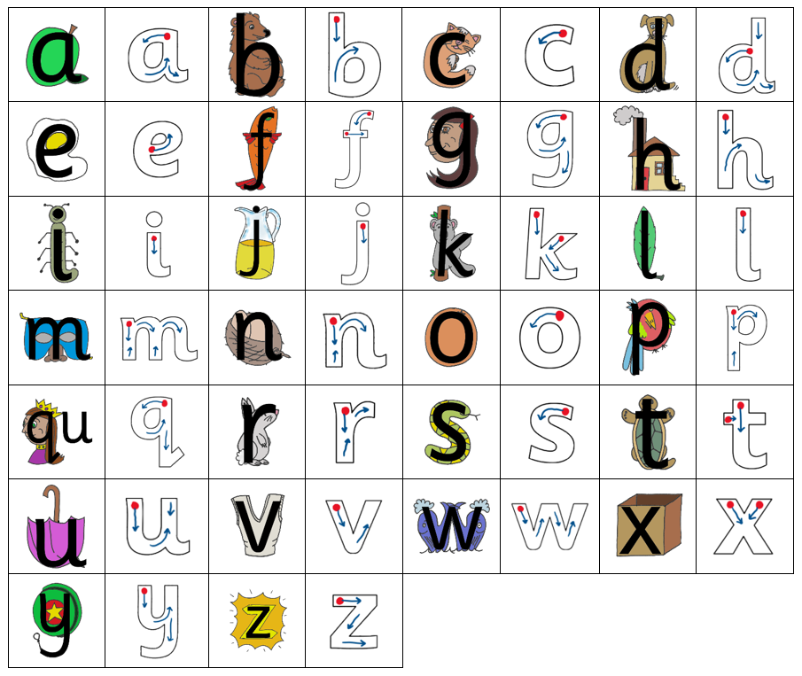
Letter formation
The pictures used to teach your child letter sounds, also help to teach letter formation.

Slide 30
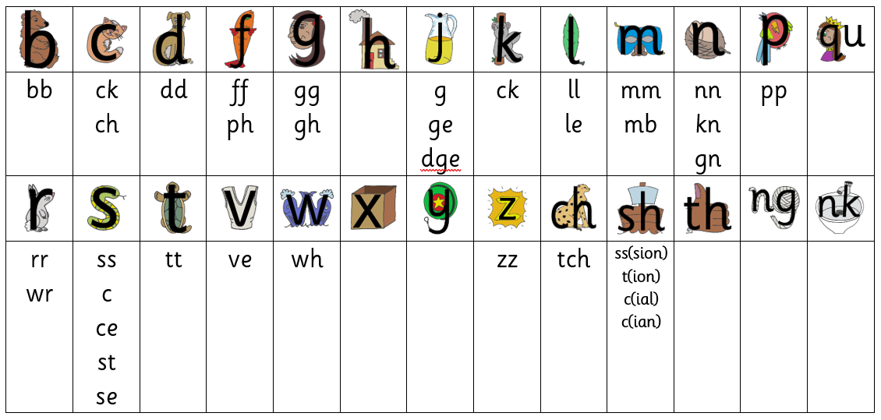
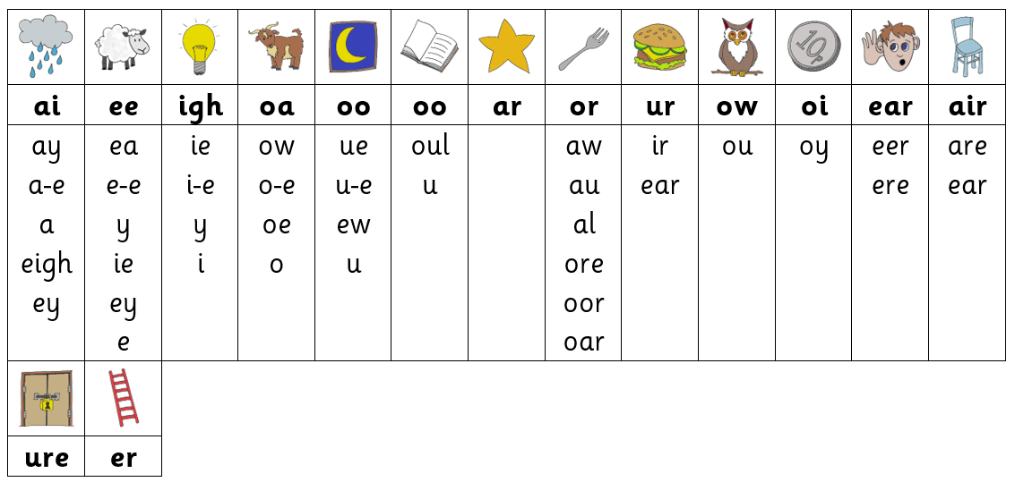

Slide 31
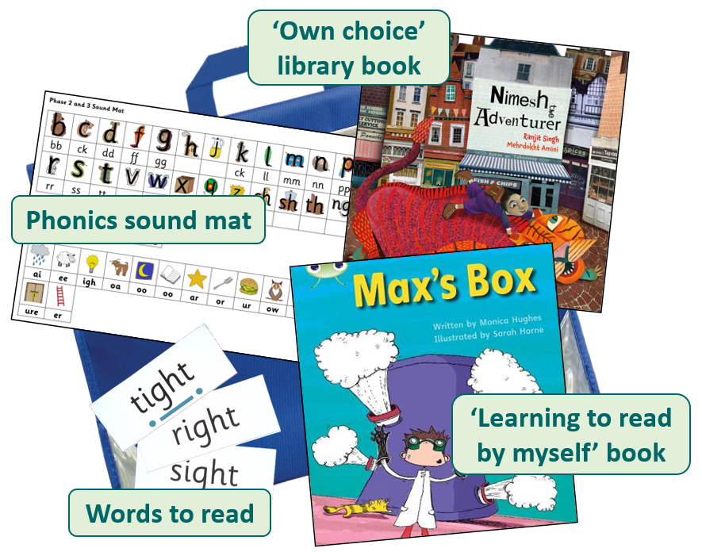

Slide 32
‘Learning to read by myself’ book
This book will contain words that your child can read or ‘sound out’ and then read.
Your child may bring the same book home over a couple of evenings. This is because re-reading helps your child become confident and more fluent.

Slide 36
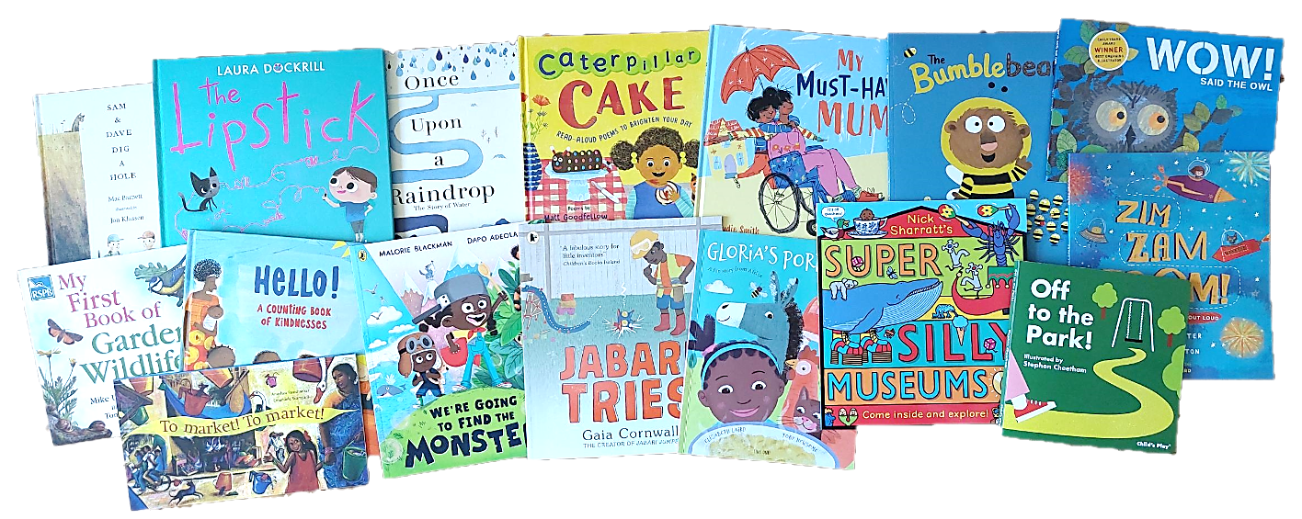
‘Own choice’ library book

Slide 37
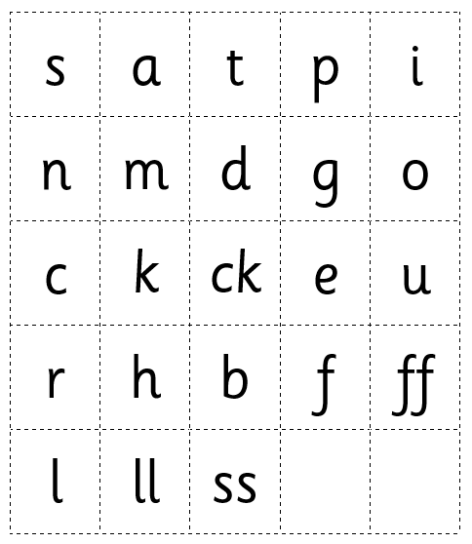
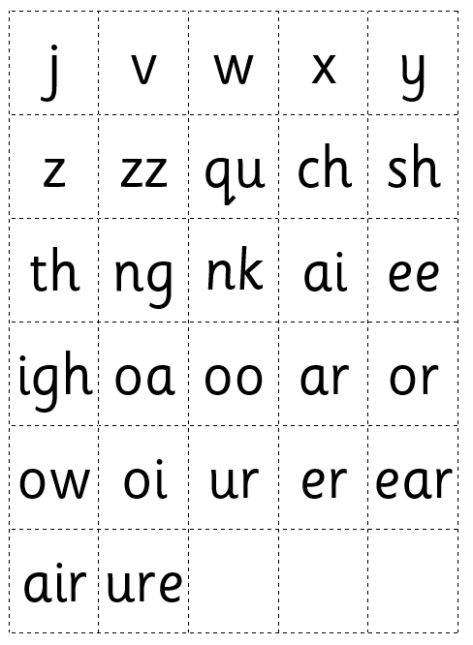
or
Your child might bring home a set of sounds on card that you can cut up and build lots of different words to read.

Slide 38
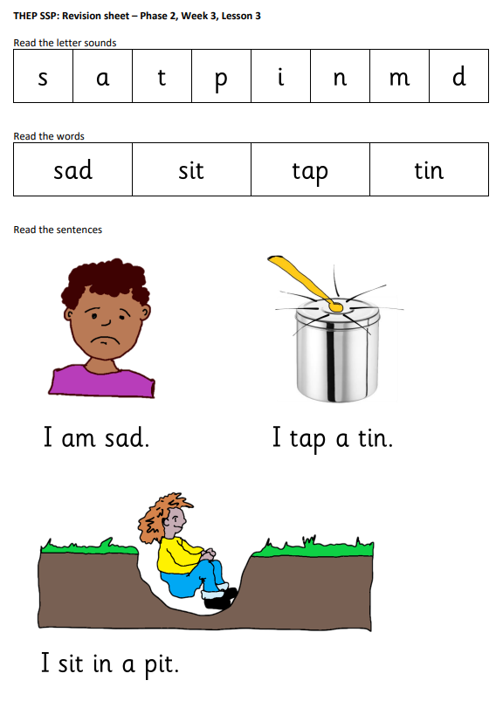
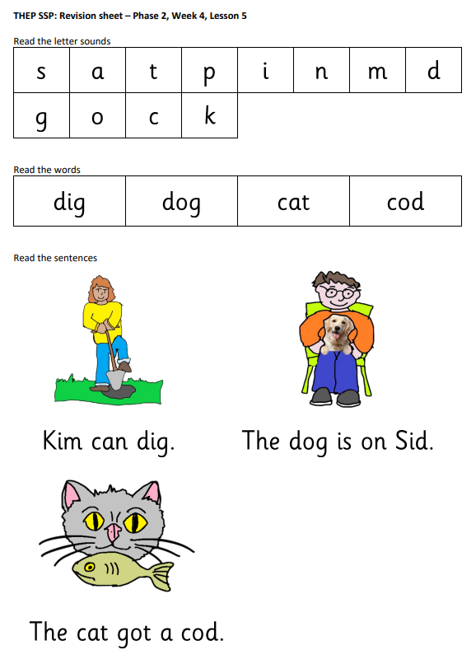
Your child may bring home some of these sheets.
Over-learning is phonics helps your child grow in confidence with their word reading.

Slide 39
Reading for pleasure
Let children read what they want. Let them read for pleasure.
Any form of text that will help children develop a love of reading e.g comics, magazines, books that capture their interest.
Visiting the library, books in the home
Benefits of reading for pleasure –
improves vocabulary, improves reading attainment and writing ability
greater self confidence as a reader
General knowledge
Better understanding of people and cultures

Slide 40
How to help your child at home
Listen to your child read regularly
Read to your child
Talk about books, stories and words
Use pictures to discuss stories
Explore word meaning together
Let children see you read
Give your child the gift of reading!

