Slide 15
Can you make sense of this?
In a puiltacibon of teh New Scnieitst it siad you cuold jublme all teh letetrs in a wrod adn as lnog as teh frist adn lsat were the smae, reibadailty wolud hadrly be aftcfeed. My ansaylis did not cmoe to mcuh beucase of teh thoery at the tmie but raserceh sugsegts we may hvae smoe pofrweul palrlael prsooscers at wrok, which seepd up regnicoiton. We olny need the frist and lsat letetrs to spot chganes in meniang.

Slide 16
Spelling is a mental process To support children well, we need to be aware of the mental processes involved
Say the word
Visual memory of the word
The feeling of correctness
Correct spelling

Slide 23
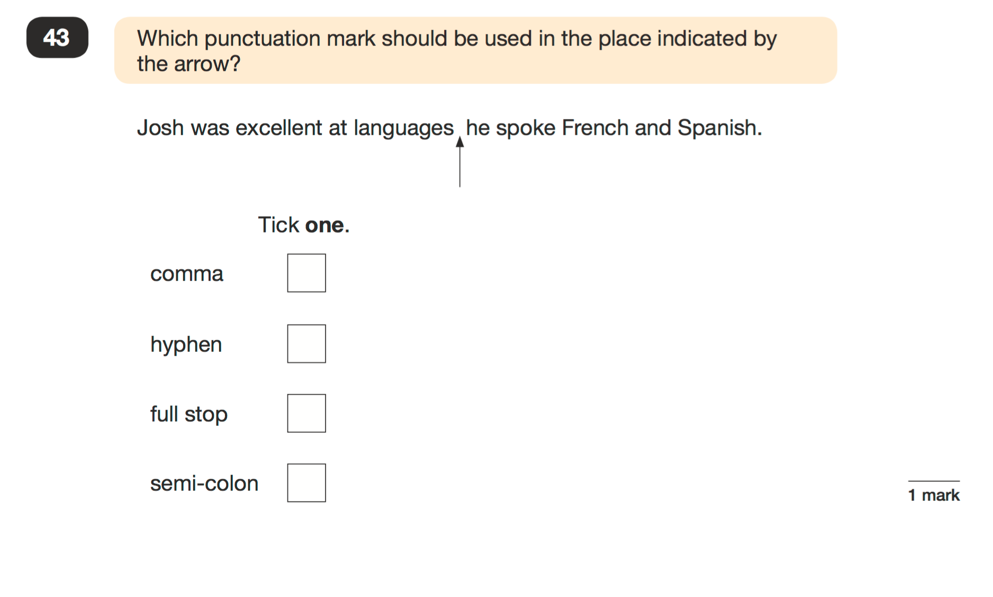

Slide 24
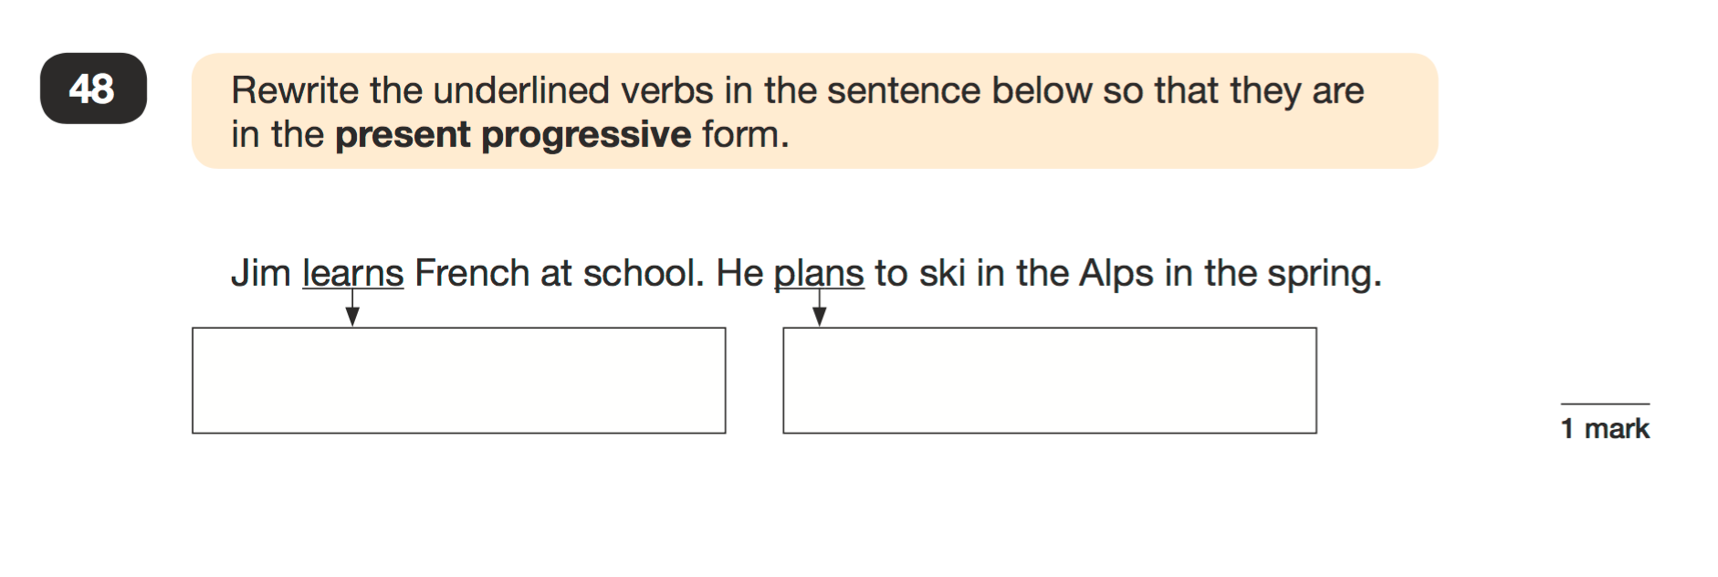

Slide 26
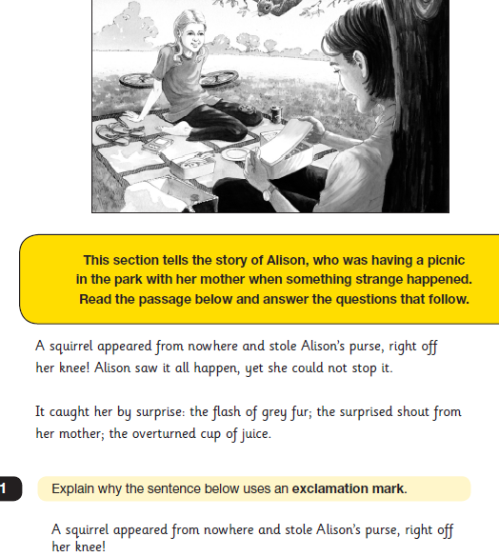

Slide 27
